Slide 1
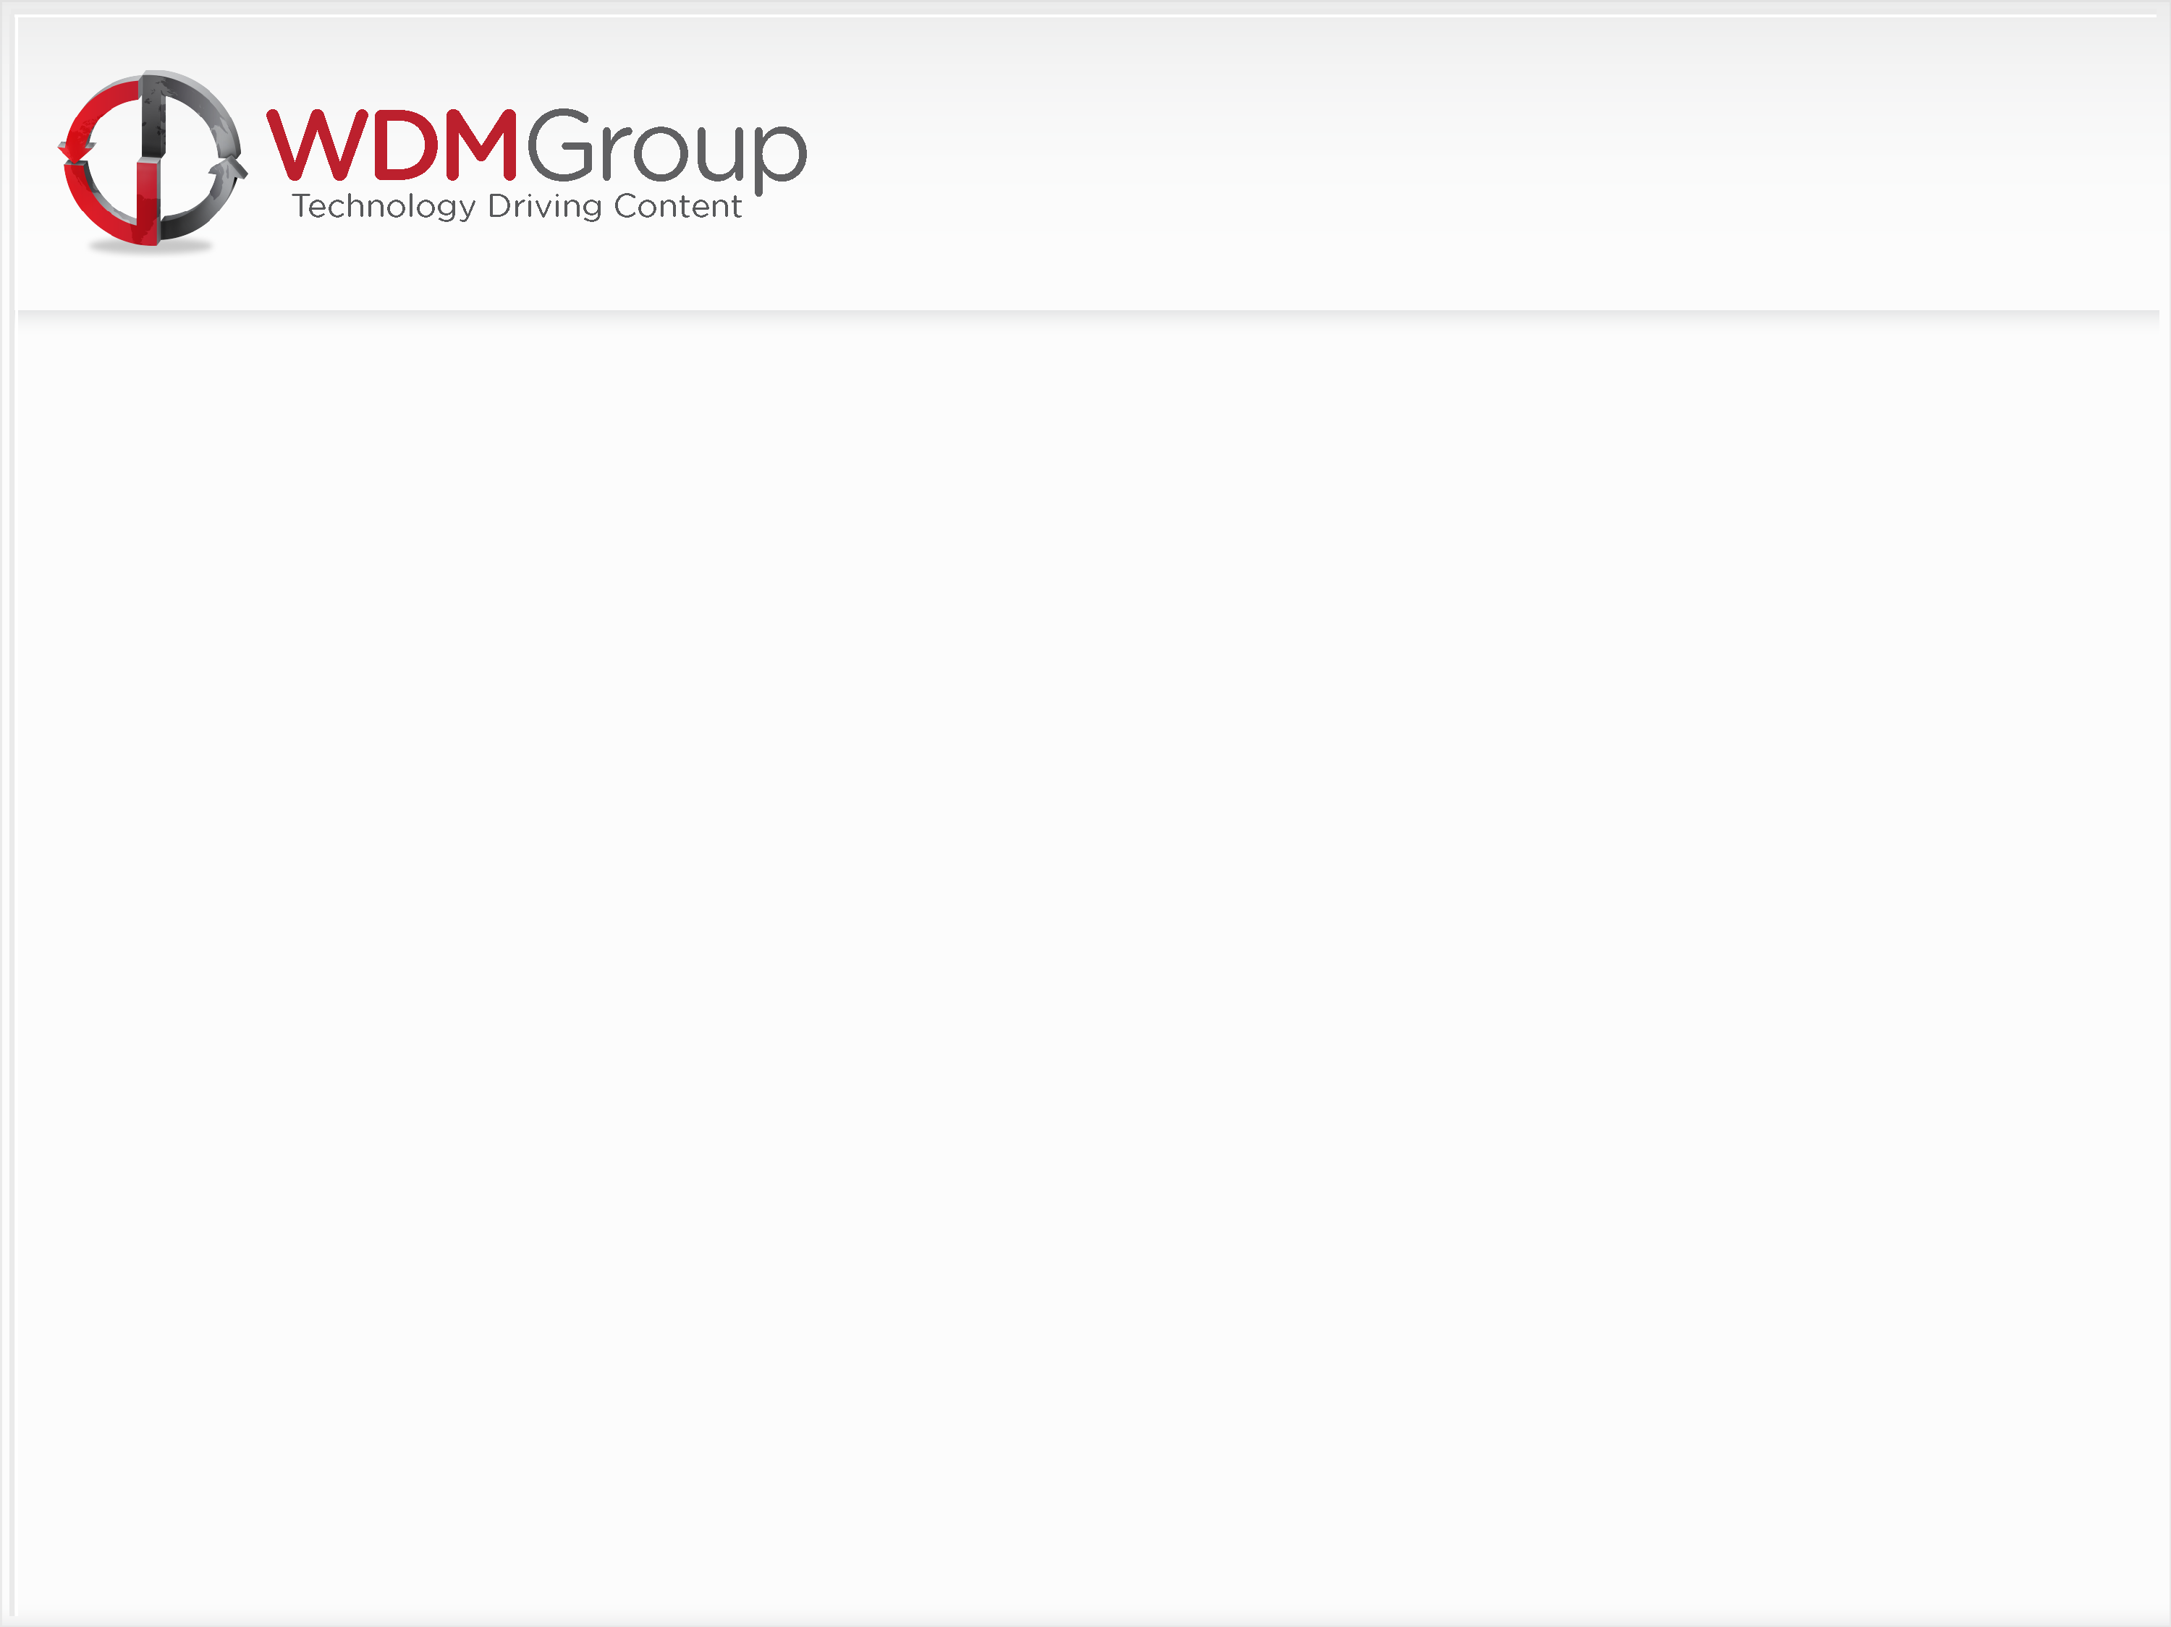
Welcome To WDM Group
Training Induction for Research & Project Directors

Slide 2

Personal Background
WDM Group
Introductions

Slide 3

Personal Background

Slide 4

What To Expect?
Today:
History of WDM Group
Vision Statement
Mission Statement
The Numbers
Products – Magazines/Websites
Divisions & Regions
Future Growth – Plans/Projects
What Do We Do?
What Do We Offer?
How Do We Do It?

Slide 5
What To Expect?
Day Two:
Suspect – Listen & Learn
A full 2 hour session sitting with
one of our Senior RD’s in order
to gain valuable insight into their calls
Objection Handling
A review of Session 1 to look at common objections and how to overcome them
Research & Marketing
A more in depth look at the preparation required before we can hit the phones -
Sector Packs
Spidergram
iGram
Understanding your Market/Territory
Media Partnerships
3 Month Planners
Lead Spreadsheets
Day Three:
Sector Presentation
A 10 minute PowerPoint presentation on your industry
Suspect Role Play
Association Set Up
Lead Preparation
Practice Calls

Slide 6
History of WDM Group
Established January 2007.
Four Call Centre’s opened within 32 month followed by period of rapid expansion.
San Diego / Toronto / Boston / Norwich
Mumbai Opened October 2010
Current Group Turnover $12 Million.
Number of Employees: 145.

Slide 7

Mission Statement
To become the leading Global Publisher of Digital Magazines.
To offer our clients a diversity of products.
To provide high quality, relevant and topical news reports to our reader base.

Slide 8
Vision Statement
To develop a vibrant office environment through motivation of our staff.
To demonstrate loyalty to our employees.
To ensure that recruitment, training and development remain a core strategy.
To offer our staff the prospect of development from within the business.
To provide the business with an experienced and professional Management Team.
To offer our clients fast paced web-sites and newsletters.
To generate growth in Web traffic.
To introduce a Social Media Platform which is trusted by Global Business Executives.

Slide 9
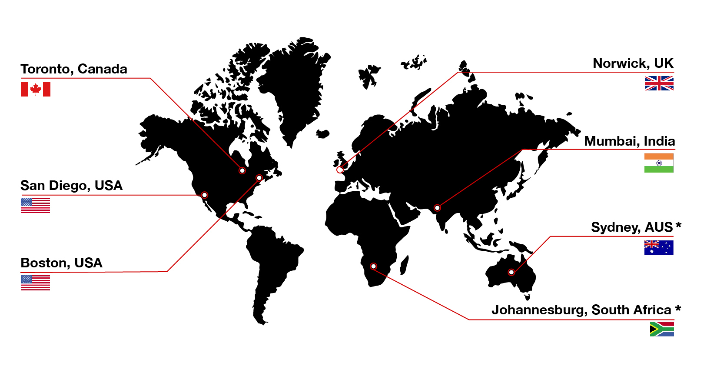
Global Presence

Slide 10

The Numbers
Previous Growth & Targets

Slide 11
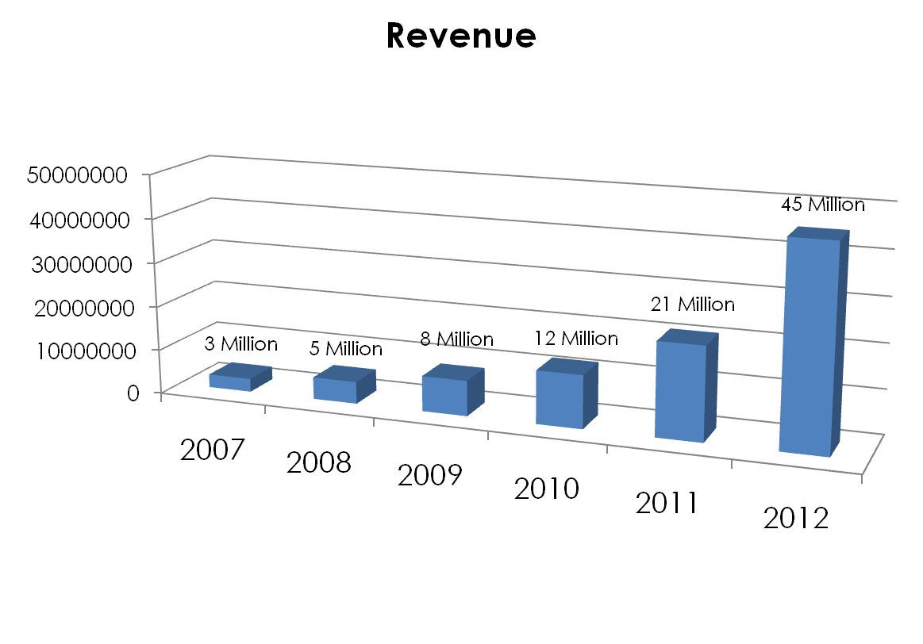
Previous Growth & Targets
2012: 300 Staff
2011: 200 Staff
2010: 160 Staff
2009: 100 Staff
2008: 70 Staff
2007: 40 Staff

Slide 12





Brand Structure
Business Reviews
Industry Channel
Digital Media Marketing

Slide 13








Brand Development
Business Reviews
Industry Channel
Database Channel
Digital Media Marketing
Lifestyle Channel
Social Media Channel
Venbi

Slide 14
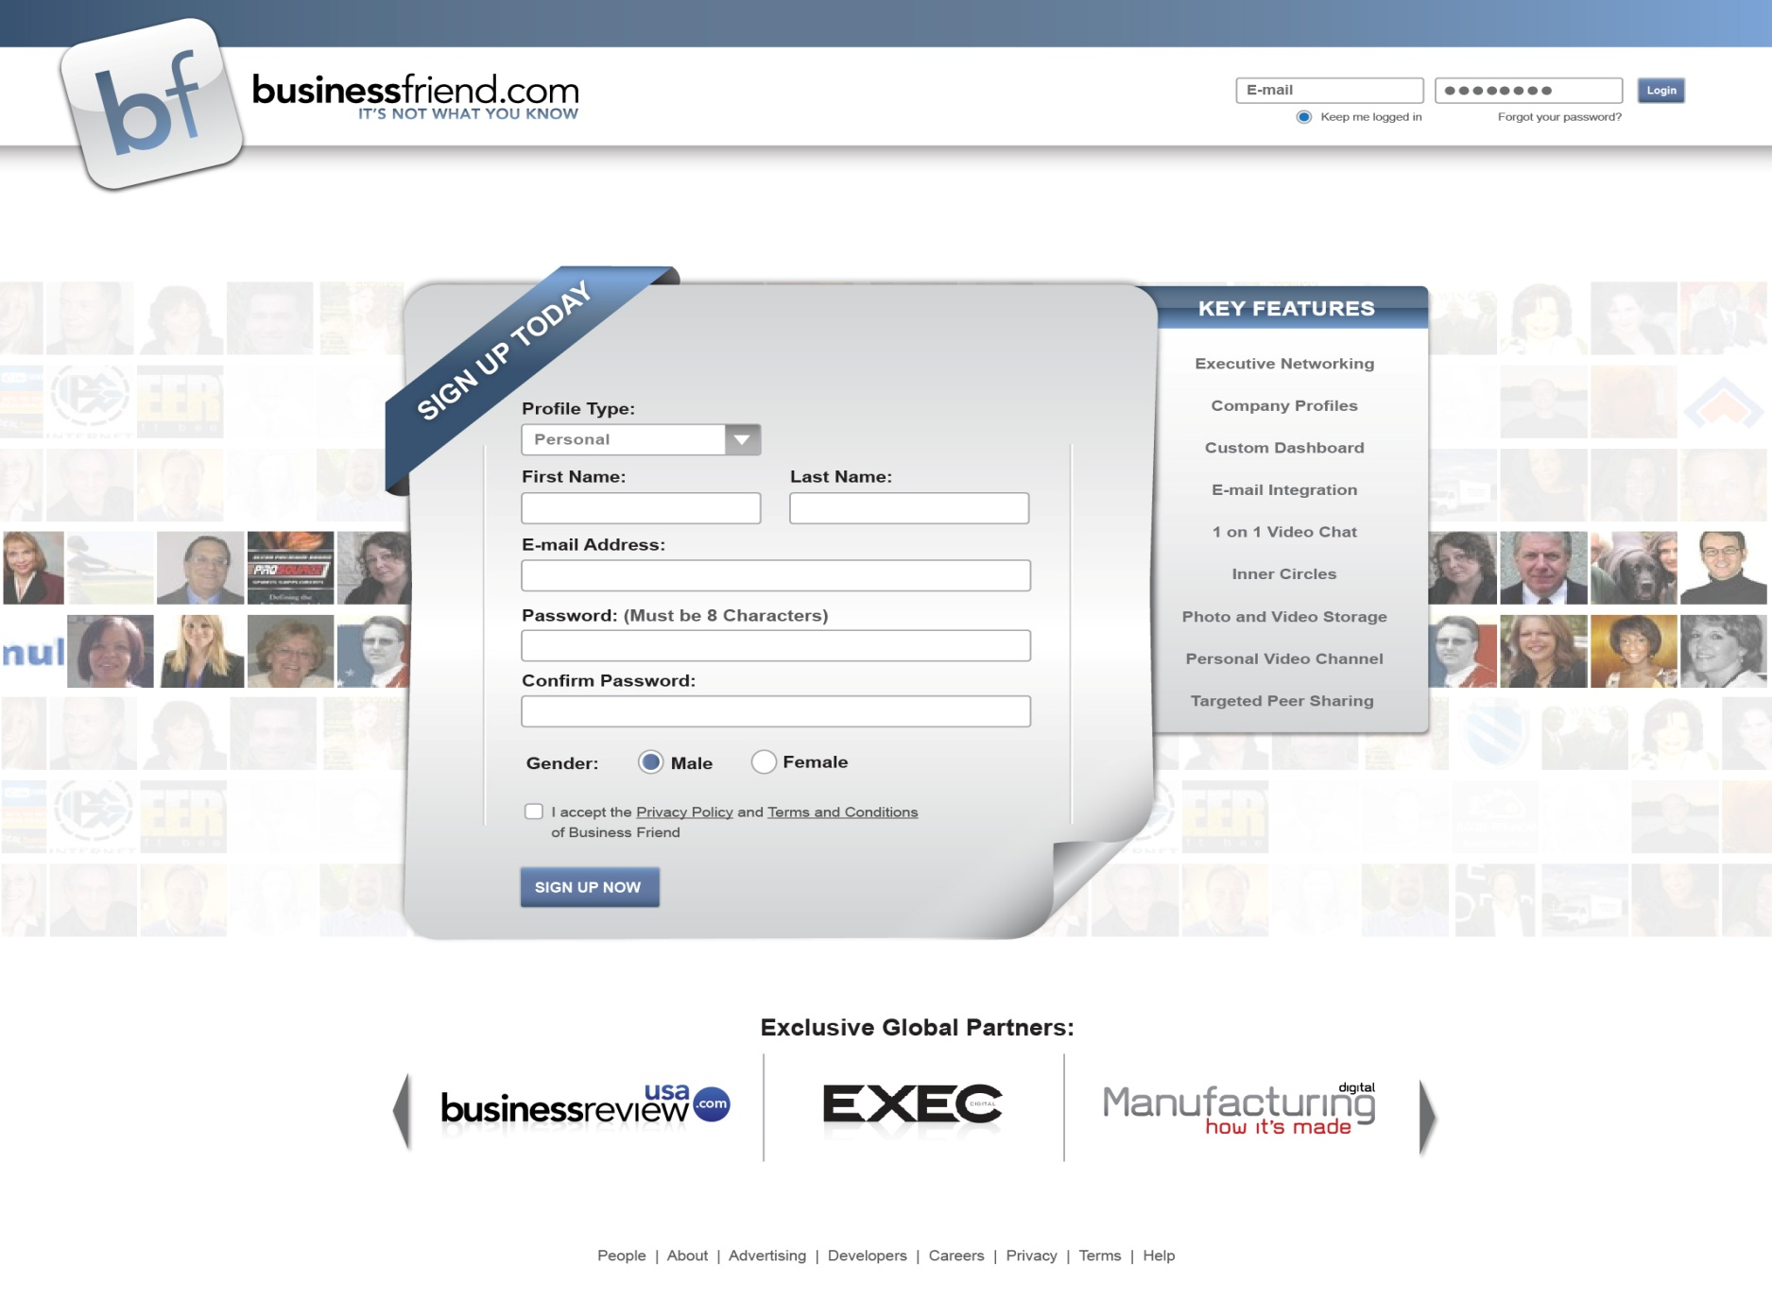
Business Friend

Slide 15
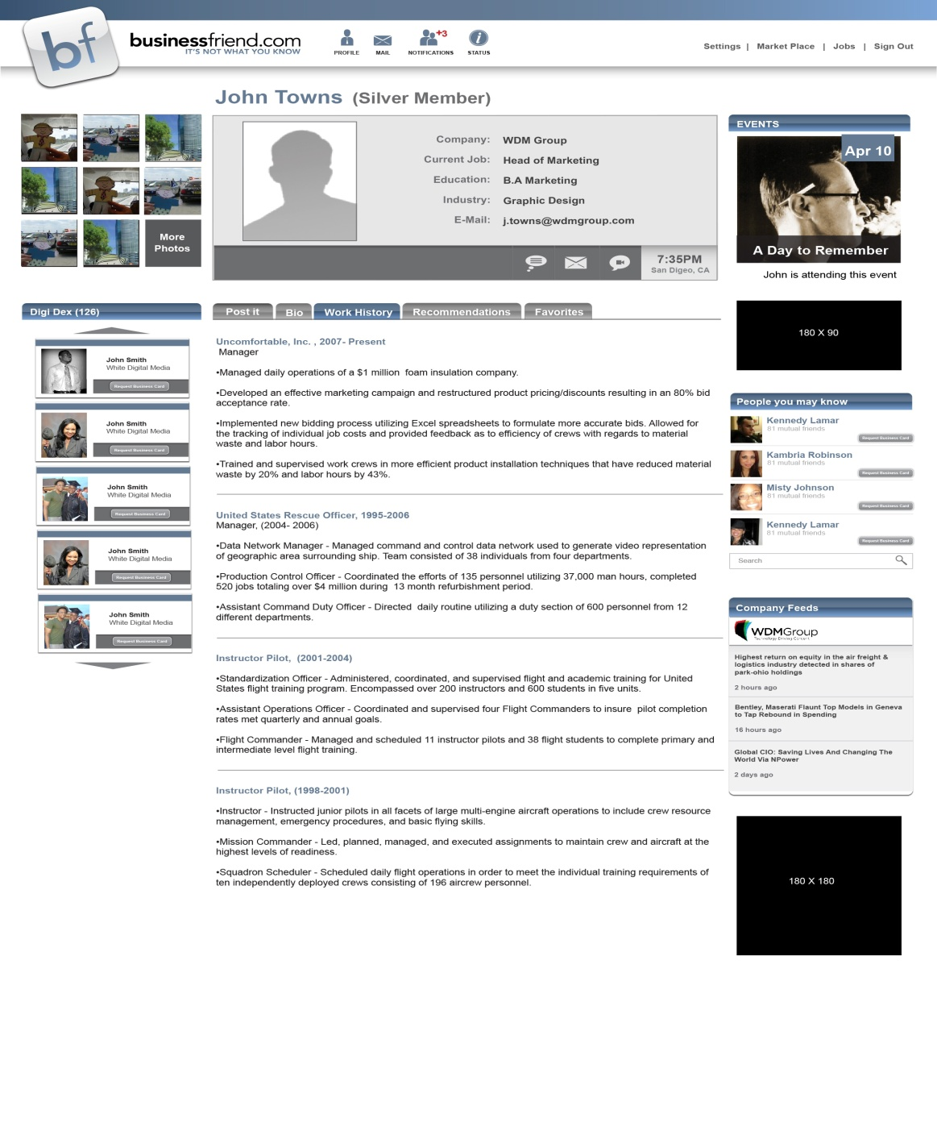
Business Friend

Slide 16

What Do We Do?

Slide 17
Profiles Business Model
Revenue Generation through a ‘Vendor Model’
“Selling By Association”
Client Relationships
Supplier Partnerships
Contract Wins & Tendors
Investments & Awards
Business Partnerships
As Simple As - “Company ‘A’ supports Company ‘B”

Slide 18
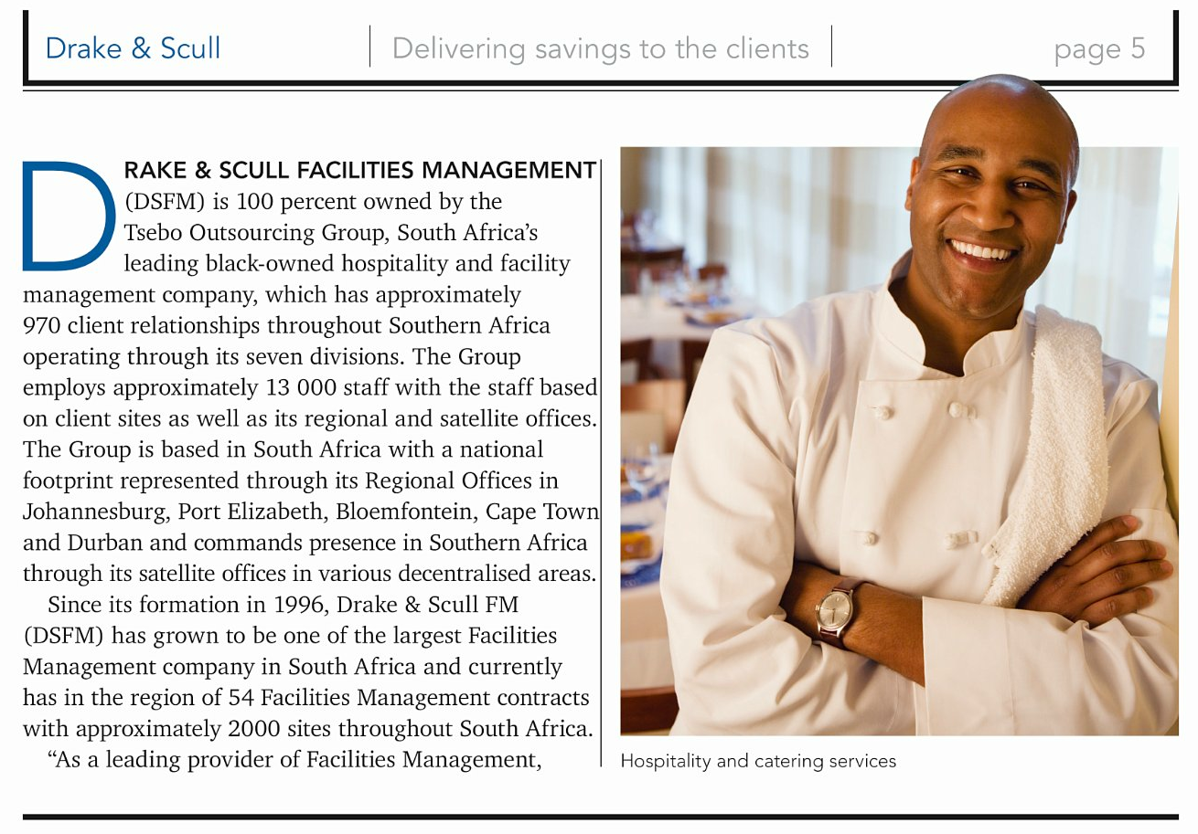
Profiles Business Model
Examples

Slide 19
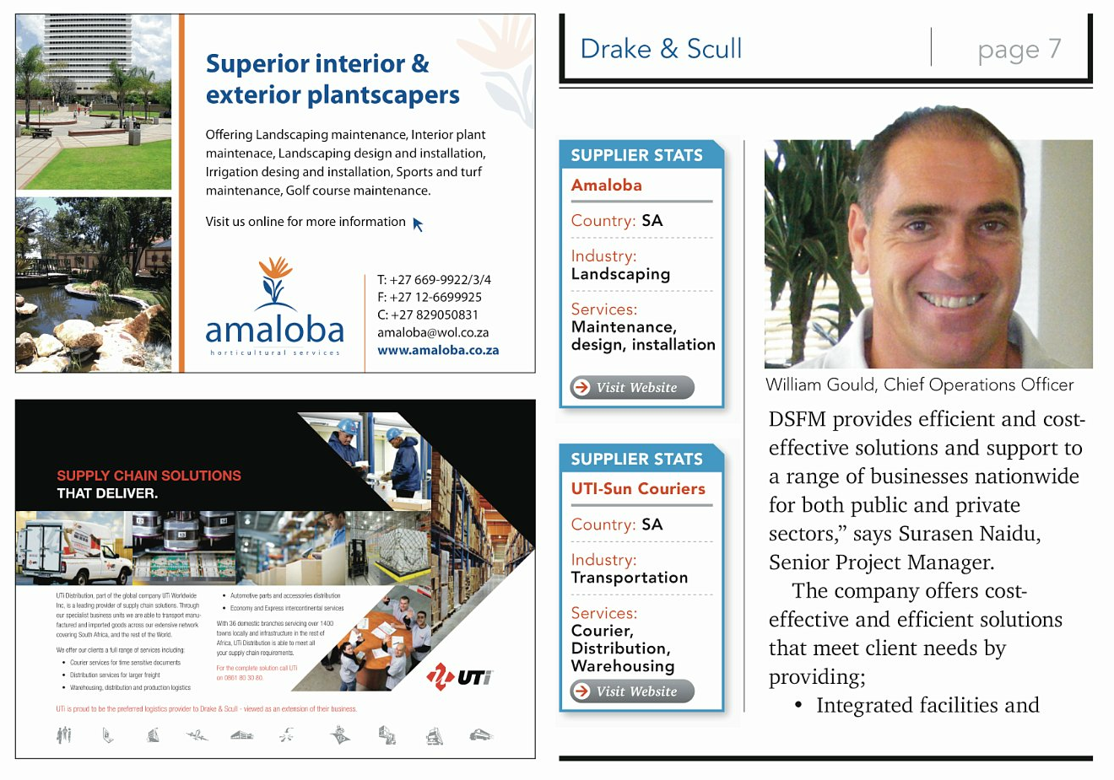
Profiles Business Model

Slide 20
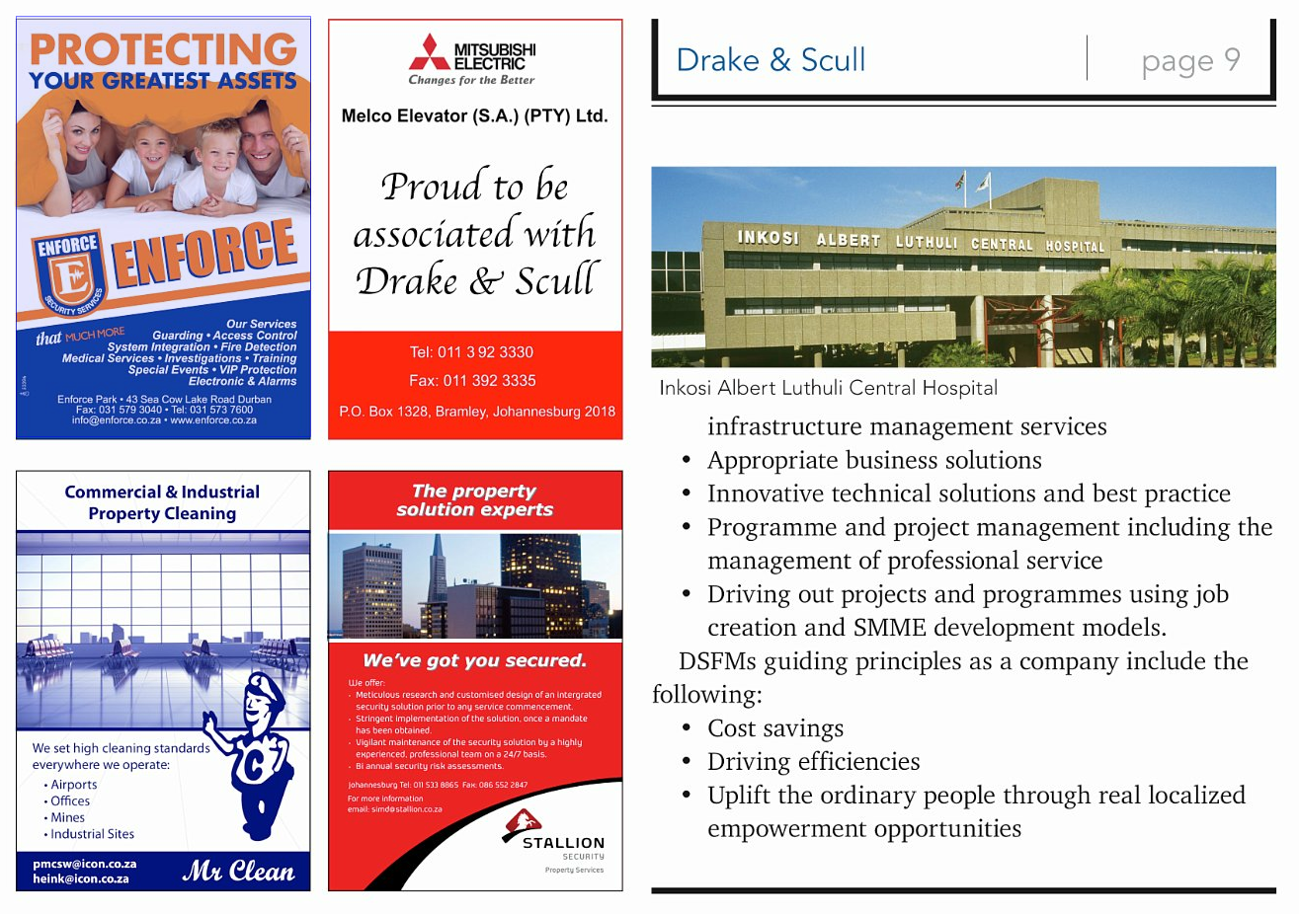
Profiles Business Model

Slide 21

What Do We Offer?

Slide 22
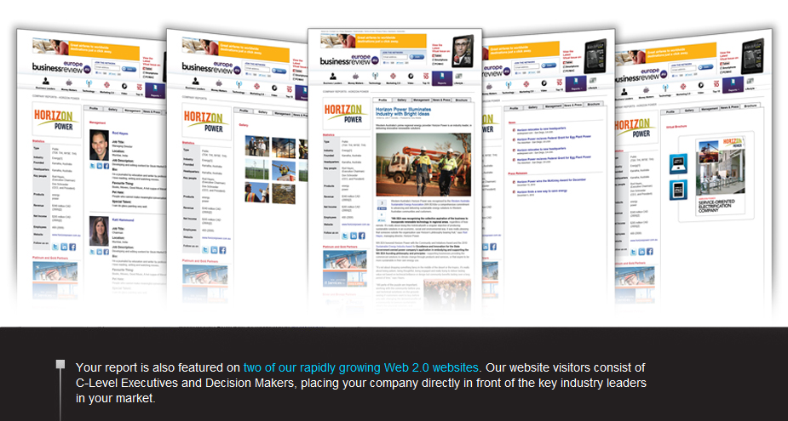
What Do We Offer?

Slide 23

What Do We Offer?

Slide 24
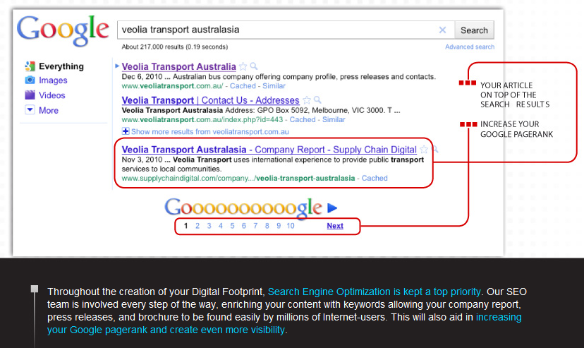
What Do We Offer?

Slide 25
What Do We Do?
www.digitalmediamarketing.com

Slide 26
How Do We Do It?

Slide 27
Key Performance Indicators
Daily Activity:
4 Sessions
3 Hours
100 Calls
Weekly Input:
8 Suspects
4 Prospects
2 Approvals
Monthly Revenue:
£15,000 / $ 24,000
Session 1: Suspect Frenzy – 40 Calls, 1 Hour and at least 1 Suspect
Session 2: Prospect Follow Up – 25 Calls, 45 Mins, at least 1 Prospect
Session 3: Suspect Frenzy – 40 Calls, 1 Hour and aim for another Suspect!
Session 4: Phone Melt Down! – Whatever you need to do to hit your daily targets – 25 Calls and 30 Mins minimum

Slide 28
10 Point Plan
Leads
Hooks
Angles
Suspect - Introduction
Suspect - Information – Top Floor to Shop Floor
Suspect - Close & Consolidate
Prospect - Reintroduction
Prospect - The Process
Prospect - The Marketing Pitch
Prospect - Supplier Close

Slide 29
The Secret to Success
Without strong Research and Marketing, the entire call centre process is diluted expedentially and will generally be the contributing factor in not converting at the standard 4:2:1 and achieving revenue generation expectations. The very basis of poor LHA’s will damage your ability to achieve activity and input targets and will lead to a significant reduction in your ability to hit and make strong commission – you get OUT what you put IN!!
Glen White, Chairman & Founder

Slide 30
The Secret to Success
LHA’s + Activity = Results

Slide 31
Leads, Hooks & Angles
Leads
A sales lead is a Company, Business or Individual potentially interested in or suitable for a profile.
Hooks
A conversational common ground between you and your sales lead that allows you to introduce your project. Examples of this are Associations, Federations, Trade Shows and Exhibitions.
Angles
Points of interest or ‘Hot Topics’ that make your sales lead ‘bite’ and show significant interest in your proposal.

Slide 32
Research & Marketing (LHA’s)
Commitment
2 to 5 hours dedicated to this part of your business every week – without fail!
Sector Packs
Begin by understanding your specific industry sector and territory. Create a file of background research/history, links to the best ‘industry news’ sites, highlight the leading Associations/Federations and create a calendar of Trade Shows.
Spidergrams
It is essential that you take a strategic approach to developing Leads. Start by breaking down your Sector into individual Sub-Sectors by using a Spidergram.
iGrams
Once your Sub-Sectors are identified, the iGram will allow you to identify relevant and specific ‘Hooks’ – For each Sub-Sector you should aim to have 3 Associations/Federations and a full 12 month Calendar of the main Trade Shows and Exhibitions or Events.

Slide 33
Research & Marketing (LHA’s)
Leads
Capture and manage your Leads on the company standard Lead Spreadsheet. Use this to create a detailed account of every lead and their contact details. Each week you will be asked to email this back to us in order that we can capture the information for our Group database so make sure you fill in as much information as possible.
Hooks
Confidence in your ‘Hook’ is essential for a strong Suspect introduction. Make sure you have the authority of the Association/Expo before you start calling your Leads. A personally written ‘Foreword’ or official Event press release is the key to gaining traction with your industry leaders.
Angles
Hot topics, points of interest, latest news or industry investments and developments that allow you to talk confidently and intelligently on your industry. Angles give you the credibility you need to engage the industry leaders in conversation and begin building the relationship required to complete the process.

Slide 34
Media Partnerships
Media Partnerships are the commitment between you and a relevant, industry specific Association or Exhibition organizer
Your focus when completing your 3 Month Planner should be to set up at least 1 solid partnership with either an Association or Exhibition each calendar month
Benefits of the partnership include recognition on websites, content as a ‘Foreword’ or ‘Association Profile’ and links to our Events Calendar on our websites
Buy in from an Association also has one very important benefit for us – Leads!
Likewise Exhibitions can generate you Leads from Exhibitors, Sponsors & Keynote Speakers
Associations and Exhibitions can also be encouraged to cement our ‘Media Partnership’ to their members/exhibitors by mail shot
A pre-written ‘members mail blast’ is a great way to strengthen buy-in and clear the way for approaching your new found Leads – Suspects!
As a rule Association Profiles receive content of approximately 500 words and 3 images in the magazine – Exhibitions 50 words and a logo linked via our websites

Slide 35
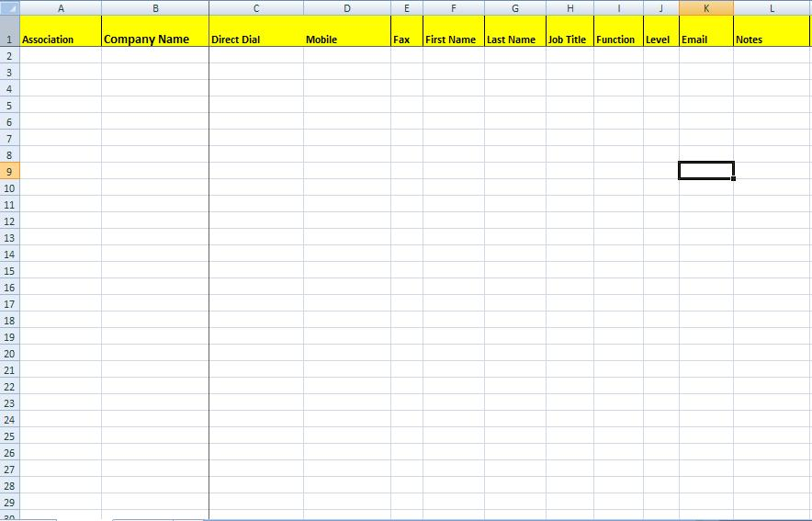
Lead Spreadsheet Management

Slide 36
The Suspect Call - Introduction
Who are you?
Introduce yourself by name and publication in an upbeat, friendly fashion.
Why are you calling?
Outline the reason for your call in a simple straightforward manner, highlighting the editorial focus on the industry.
Who are you working with?
Bring into the conversation your relationship with the industry specific Association or Trade Show – Your Hook!
What are you offering?
A short, simple description of the editorial programme and availability of one of a limited amount of editorial ‘Business Report’ positions.

Slide 37

The Suspect Call - Introduction
Key Skills…

Slide 38

The Suspect Call - Introduction
Top Tips…
The ‘Elevator Rule’
20 Seconds to engage your Suspect
Establish relevancy and credibility
The ability to naturally communicate
Disguise your ‘Pitch’ as conversation
Create a relationship
Have confidence in your ‘Hook’
A good ‘Hook’ removes the element of a ‘Cold Call’
Be polite yet respectfully persistent
Deal with objections
Sound like an expert

Slide 39
The Suspect Call - Information
Top Floor 2 Shop Floor
Working the TF2SF into the strategic approach builds credibility
Using the opening to understand the size and scale of the operations
Speed of research essential – a 10 to 15 minute exercise max!
Emphasis on people management should gain traction from top level executives
Intelligent prompting establishes control
Personalize the process with the background and career understanding

Slide 40
The Suspect Call - Information
Top Floor 2 Shop Floor -
Strategic Management –
Understanding the business structure, size, turnover and profitability. The Board and Senior management structure, the forward facing business plan and the companies ‘unique selling points’.
2. Continuous Improvement -
Looking at all aspects of how organisations are driving continuous improvement, lean, kaizen or six sigma techniques through their organisation
3. People Management -
From recruitment, retention and development, this core area explores how organisations deal with people management. people are always crucial to the success of most great companies.

Slide 41
The Suspect Call - Information
4. Supply Chain Management -
Whether organisations are using a total outsourced solution, off-shoring production or back office requirements or simply working with their top ‘business vendors’ to improve pricing and productivity.
Technology –
With the growth of Global economies, it is clear that technology will be a key driver in the future success of most companies. technology enables access to knowledge, data and content and therefore is key to any future business strategy.
6. Operations -
The shop floor is often seen as the ‘engine room’ of any business whether in production, retail, call centres or a service industry. It is useful to look at how these operations are organised, managed and maintained
Investments & Developments –
Looking at the future of the company and what level of investment or development is planned over the next 12 months.

Slide 42
The Suspect Call - Close
Close the Call…
Although not technically a ‘Sales Call’, closing the Suspect is as important as closing any deal.
Take control of the situation and deliver a clear message to your Lead as to what happens next.
Re-cap on points of interest raised in the discussion to make clear your intentions and interest.
Explain the decision making process including the ‘Editorial meeting’.
Agree a time (preferably the next morning) to call back with your decision.
Make absolutely sure you have the telephone number and email addresses, including those of the P.A if possible.
Use an Outlook appointment to further strengthen the buy in.

Slide 43
The Prospect Call
Reintroduction
Based on the strength of your Suspect Close your Executive should be waiting expectantly for your call. Keep to the appointment time and call promptly with a bright, energetic greeting.
Begin with a brief account of your ‘Editorial meeting’ and how you presented your notes from the previous days Suspect call to the Editorial team.
Confirm the Editors interest and make a point of emphasising specific details from the TF2SF interview strategy that caught the Editors attention.
Lead into the next stage of the call by confirming our intentions to feature the company with an 8 to 10 page report as part of our industry specific focus.
In particular highlight why we see this as a relevant fit and name drop some previous reports that would be of a similar nature.

Slide 44
The Prospect Call
The Process
Use the line... “Now what I would like to do following that decision is to talk you through the next steps and the process for how this will work”...
What follows will be a series of ‘positive reinforcements’ designed to put the executive decision maker at ease and put them into a “YES” state of mind.
Subliminally your executive may have been thinking...”this sounds time consuming” or “we don’t have the resources to be involved with this”.
The Process allows you to handle these objections before they arise and put your executive into a positive and relaxed state of mind.
E.g. – ‘A telephone interview at your convenience’, ‘No more than 30 to 45 minutes’, ‘a draft copy of the report written for your approval’.
Positive influence and behavioural change is an important part of any sales process. Use the delivery of your ‘positive reinforcements’ to create a positive state of “YES” over “No”.

Slide 45
The Prospect Call
The Marketing Pitch
If appropriate, direct the Executive to the DM2 website before delivering the following benefits:
Magazine coverage across 2 titles
Website coverage across 2 websites for 12 months
Written for search engine purposes and released to Google, Bing, Yahoo and all major search engines
Customized digital brochure
Interactive website plug In widget allowing their customers to share digital experience
Connecting to the WDM press release network
Promotion to the brand Facebook, Twitter and Linked In accounts
Development or creation of new social media pages
The key at this stage of the call is to be tuned in to the interests of your Executive. Are they interested in all points? Do they seem pushed for time?

Slide 46
The Prospect Call
Supplier Close
Deliver the caveat of the process based on ‘no cost’ and size and scale of the proposal
What we ask is that we can have permission to invite major vendors to participate with an advertisement
Vendors often eager to be seen as a key business partner and share exposure
Low key, professional approach and WDM Group never goes in cold
Introduce standard issue ‘endorsement letter’ for invitations - clerically handled by WDM Group
Invites sent out with media kits and followed up by projects team – yes is good, no is fine
Email detailed confirmation along with example of standard endorsement letter for their approval
Obtain details of company buyer or purchasing manager with permission to contact and discuss vendor details
Set deadlines and manage expectations of next steps

Slide 47
The Prospect Call
Keeping the Action
Typically we can expect 1 of 3 possible results at the end of the Supplier Close
Based on the reaction of the Executive to your proposal, handling the end of the call in the right way and keeping the action is essential
A P1 is the name given to a positive response where the Executive agrees to your proposal, use of the standard invite letter and contact with his buyer
End a P1 with a deadline for receiving the companies letterhead and Executive signature – 24 hours or sooner
Take contact details for a PM/Buyer and explain process for list delivery – 48 hours or sooner
A P2 is still a positive response but typically sees the Executive request to deliver the list themselves – This can be handled as an objection
Explain reasons for dealing with PM/Buyer as less time consuming for the Executive as well as a more thorough approach to highlighting key vendors
Attempt to ‘Flip’ P2’s into P1’s by handling objections on time/deadlines/workload etc…

Slide 48
The Prospect Call
Objection Handling
Occasionally the Supplier Close will be less successful and the Executive will question the vendor model or decline the opportunity – P3
In this instance we attempt to immediately overcome the Executives objections
First understand the objection – what are their concerns/issues?
Take a strategic approach to handling these issues, repeat the objection back to them offering a solution
Empathize – Feel, Felt, Found is a great technique for this e.g “I understand how you feel, others have felt the same way, what they found”
Offer examples of previous reports and brochures from within their sector – Chose successful projects with ample advertising and demonstrate the completed article
Offer testimonials as an example of our best practice within the industry

Slide 49
Prepare To Make Money!
Final Preparation
PM Call
Copy PM into Prospect confirmation email and follow up with a call
Explain the product offering and the size and scale of the editorial/marketing program
Explain the full ‘supplier close’ approach, why and how we do the program
Negotiate the timeframe and direct list delivery requirements and emphasize the importance of the timeframe
Letterhead Delivery
Arrange to receive direct from Executive or via a PA within 24 hours of the Prospect call
Note: Receiving the Letterhead/Signature on time shows commitment and buy-in from Executive
List Delivery
Send an email reminder to list provider the evening before the scheduled due date
Chase any outstanding lists promptly and put emphasis back on Executive buy in and editorial deadlines
Maximization/Optimization
Never except the first list as complete. Once received revisit the PM call to obtain more contacts
Qualification
Decision makers names, numbers, fax and email
Attention to detail at this stage can lead to less failed emails, Project Directors dealing directly with decision makers, more deals and…more commission!

Slide 50

Question Time

Slide 51

James Pepper Group Training & Development Manager Email: james.pepper@wdmgroup.com Direct Line: 0044 (0)1603 217544 Fax: 0044 (0)1603 617082
View all of our products at our corporate site: WDM Group www.wdmgroup.com
112-114 Grosvenor | Prince of Wales Road | Norwich | NR1 1NS

